Slide 1


CPR for Feet
Duncan Stang MChS, FC PodMed, FFPM RCPS (Glasg)
Diabetes Foot Coordinator for Scotland

Slide 2
National campaign in Scotland
CPR for Feet
What is it?
It is a very simple system to make sure on admission to hospital or any care setting every patient:
Have their feet Checked
If their feet are at risk, they are Protected
If they are discovered to have an existing problem, then they are Referred appropriately

Slide 3
Why did we feel we needed such an initiative?
Scottish Diabetes Inpatient audit of 1,048 inpatients revealed that;
2.4% of in patients with diabetes developed a new foot lesion whilst in hospital
57% of in patients had not had their feet checked
60% who were discovered to be at risk of developing a foot ulcer did not have any pressure relief in place

Slide 4
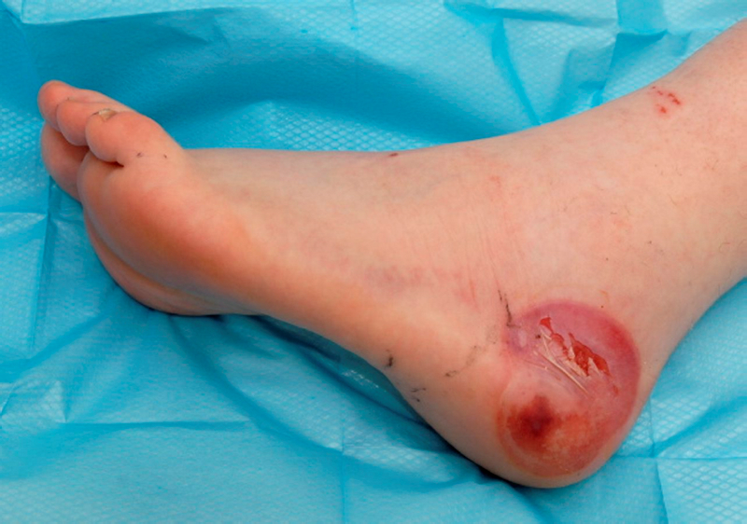
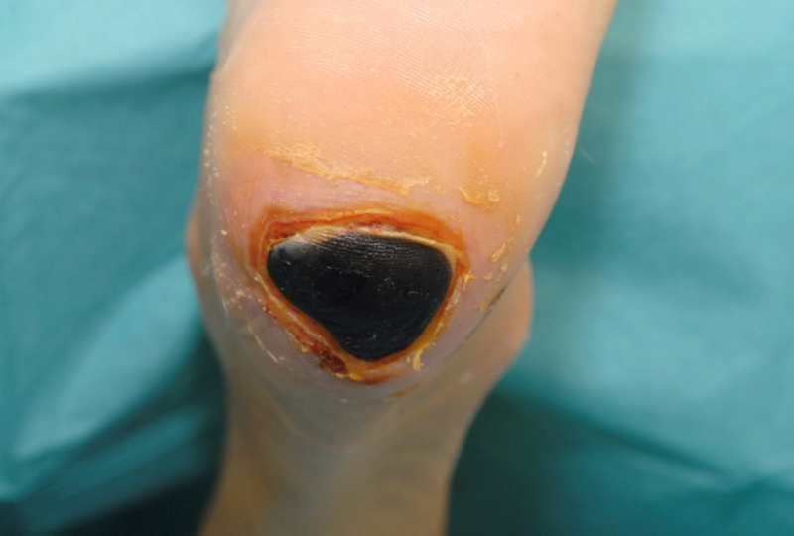
So what are we trying to avoid?
We need to prevent the preventable!!!

Slide 5
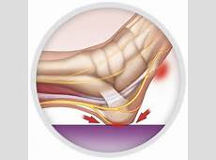
Why do we need to be especially concerned about the heel?
Pressure ulcers on heels are the
second most common after the
sacral area.........why?
Thin subcutaneous tissue found on
the heel between skin and bone provides
little protection from forces such as pressure
shear and friction

Slide 6
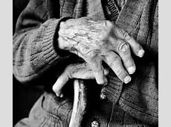
Who is “at risk”?
Elderly
Frail
Immobile/bedbound/
chair bound
Malnourished
“Special risks” – diabetes, vascular disease, CVA, renal impairment, during surgery, post operative patients

Slide 7
Recent Guidelines in Scotland
NHS Education for Scotland in partnership with Healthcare Improvement Scotland and the National Association of Tissue Viability Nurses Scotland have developed resources to help understand pressure ulcers - how they form, how they are treated and crucially how they can be prevented
Key Message
The cost of prevention is less than the cost of treatment
Decreasing the incidence of pressure ulcers releases staff resources and hospital beds

Slide 8
Why do we need
CPR for Feet?
Hospital acquired foot ulceration is...........
Unnecessary
Delays discharge
Is easily preventable
Causes unnecessary distress to patients
Costs our National Health Service vast sums of money
Results in litigation

Slide 9
The introduction of CPR has been challenging
My role as Diabetes Foot Coordinator for Scotland is ‘advisory’
I felt I needed some ‘help’

Slide 10
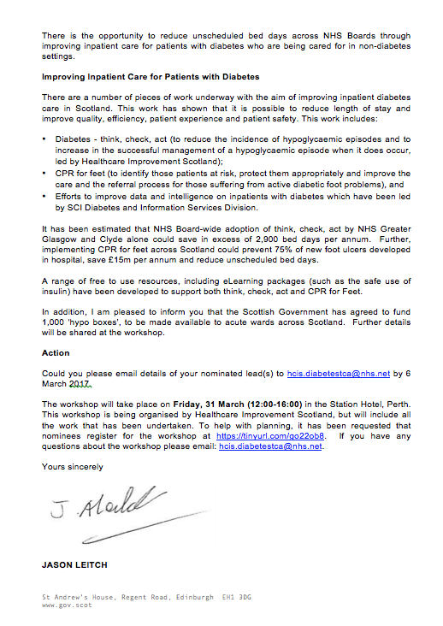
Help came on the 1st March 2017
CPR for feet. To identify those patients at risk, protect them appropriately
and improve the care and referral process for those suffering from active diabetic foot problems

Slide 11
This resulted in..........
Shona Robison MSP, the then Cabinet Secretary for Health and Sport, during the Patient Safety debate in the Scottish Parliament, referring to the CPR initiative to prevent hospital acquired foot ulceration and subsequently avoid harm to patients in hospital

Slide 12
New pressure relieving/reducing range approved for use in
NHS Scotland
Introduced via the Clinical Advisory Panel (CAP) process in consultation with Infection Control, TVS’s, Ward staff & Podiatry
Legal process
Award of the National contract
Lowering of cost of devices
Ensuring quality
Evidence based and clinically effective
Commitment to support each HB around the country with training
Will save us as clinicians valuable time and the National Health Service £££

Slide 13
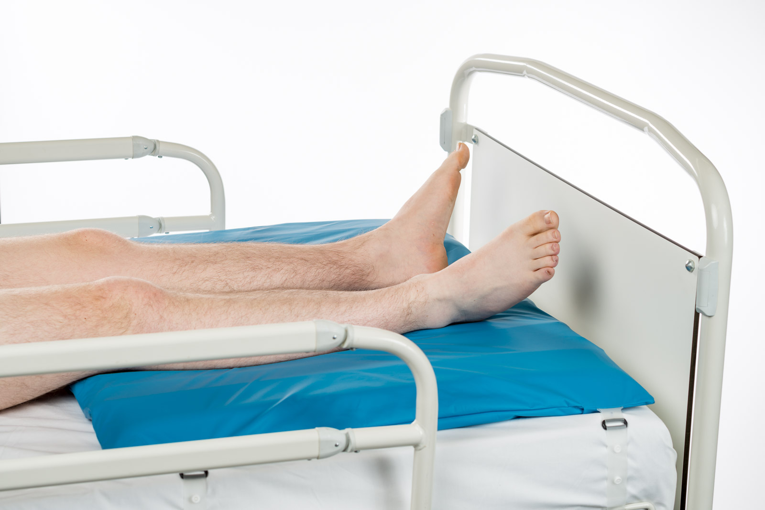
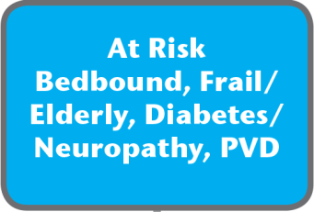
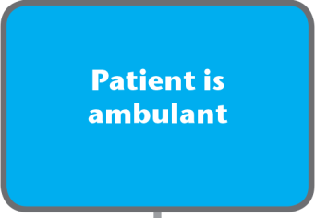
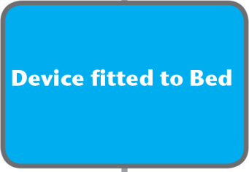
At risk and ambulatory
HeelSafe

Slide 14
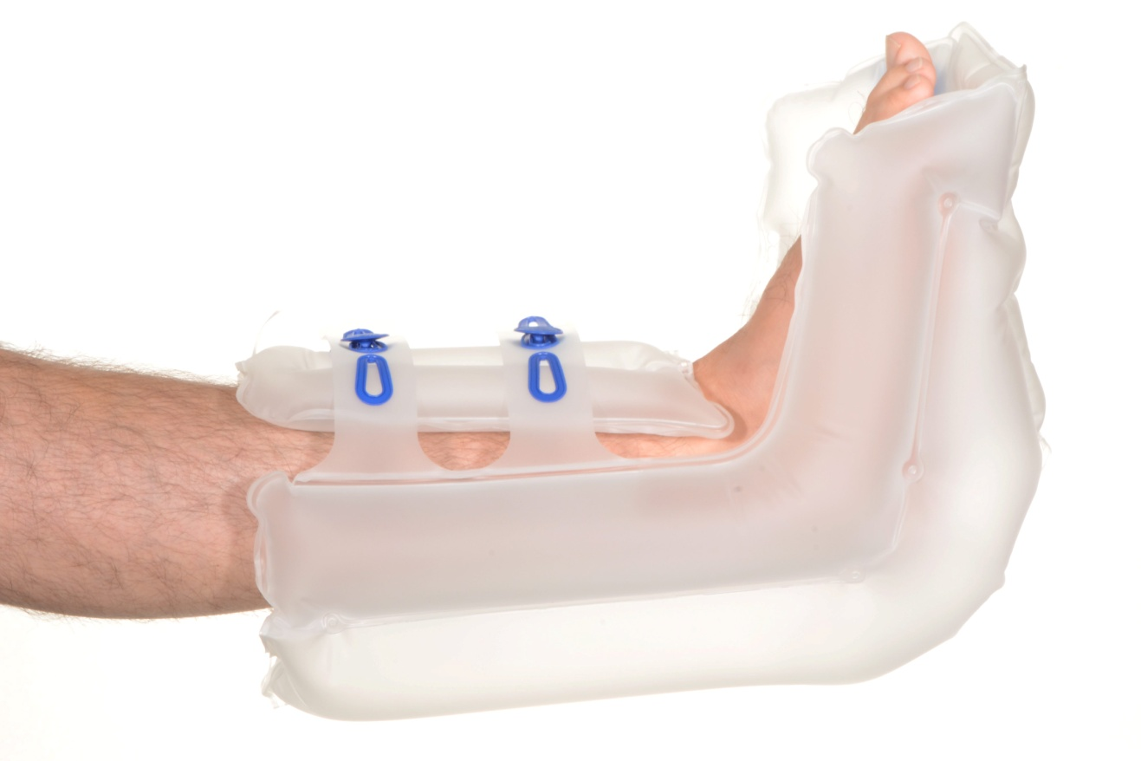
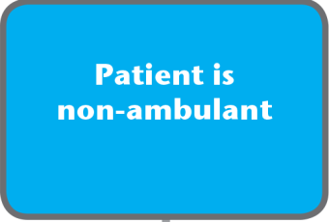
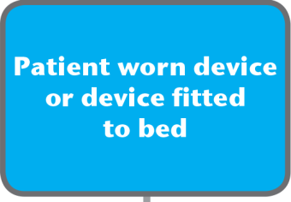
Patient who is at risk and non-ambulant

Slide 15
CPR posters and pressure relieving algorithms
Ensure each ward has a CPR for Feet poster and a simple pressure relieving algorithm

Slide 16
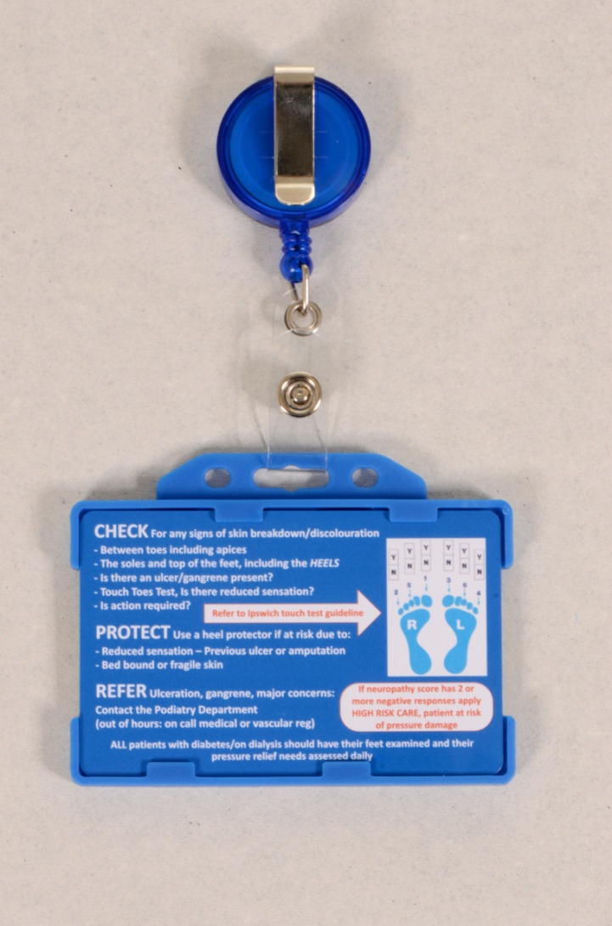
CPR badges
Double card holders
Name badge and CPR card
Constant reminder
Inspection mirror on back
Ordering information
www.respond2pressure.com

Slide 17
Ward based training
Get ‘buy in‘ from Chief Nursing officer, TVN’s and ward sisters
Training carried on the ward
Encourage a culture of preventing avoiding pressure damage
Encourage a culture of DATIX if damage does occur
Not with a ‘blame’ culture but a culture of learning and improving

Slide 18
LEARNPRO MODULE
Gives an overview of diabetes foot disease/risk
Simple but with good practical information/ knowledge
Case scenarios
Touch the Toes test

Slide 19
New on line training resource
New Resource – CPR for Feet – link on Diabetes in Scotland website – Groups - SDFAG
The resource: An instructive educational tool for clinical and social care staff engaging with patients and persons at risk
https://learn.nes.nhs.scot/3704/rrheal/healthy-aging/cpr-for-feet
Developed by SDFAG working alongside and supported by........

Slide 20

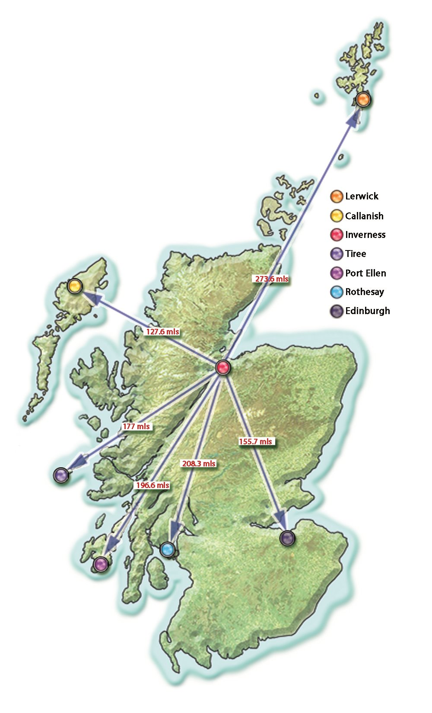
RRHEAL 10 Year Anniversary
#RRHEAL10
Inclusive,
Distributed & Accessible Education for Remote, Rural and Island Teams

Slide 21
Learning Outcomes
Principle Aims of Learning Resource is to:
Raise awareness of the importance of CPR for Feet
How to apply CPR for Feet to individual patients/clients in a health and social care setting.

Slide 22
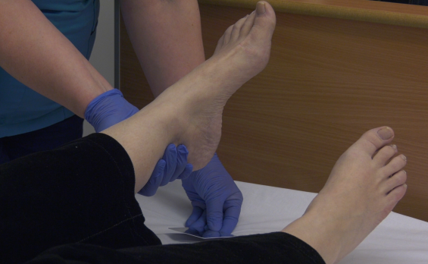
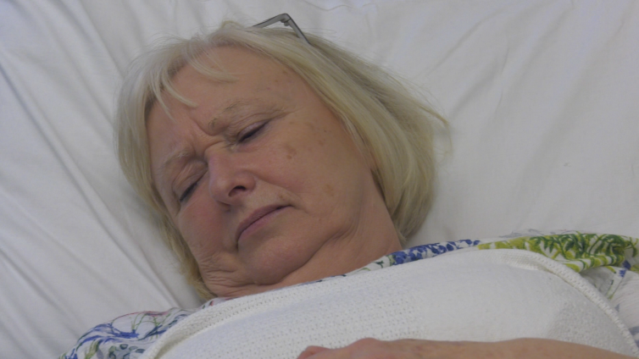
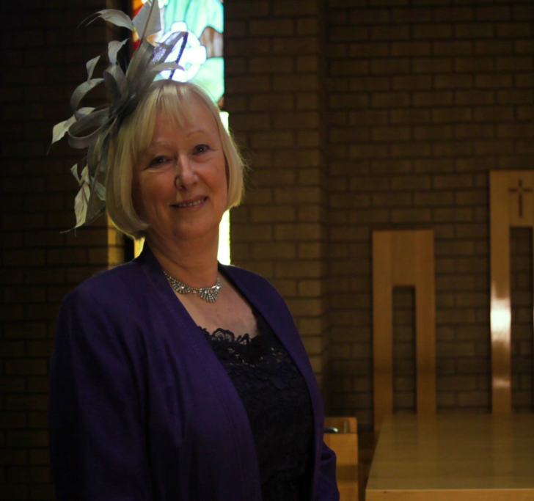
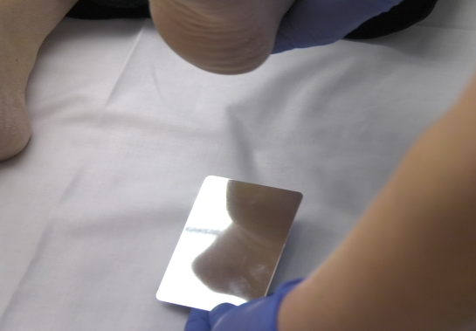
Scenario
Case based
Context rich
Role modelled best practice

Slide 23
So think about introducing
CPR for Feet
Prevent avoidable harm
Prevent litigation
Save valuable budget
Improve QOL for our patients
And really just do what we should all have been doing all along!!

